Slide 1


Slide 2
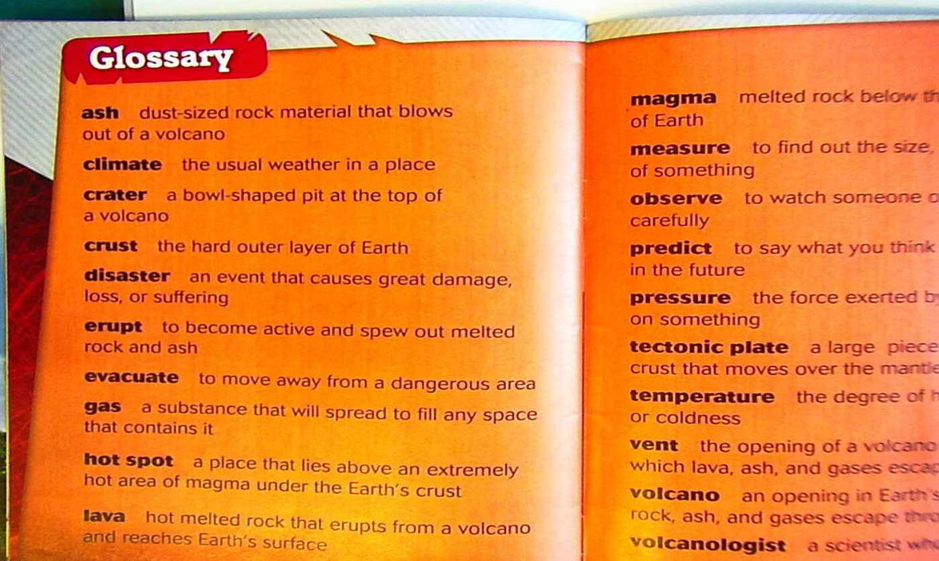
A GLOSSARY is a list of terms that is traditionally presented at the end of an academic paper, a thesis, a book, or an article. The glossary should contain definitions for terms in the main text that may be unfamiliar or unclear to the average reader.

Slide 3
HOW TO WRITE GLOSSARY
IDENTIFY THE TERMS IN THE MAIN TEXT THAT NEED TO BE IN THE GLOSSARY;
CREATE DEFINITIONS FOR THESE TERMS;
TO CHOOSE THE FORMAT FOR THE GLOSSARY TO READ EASILY.

Slide 4
HOW TO IDENTIFY TERMS
FOR THE GLOSSARY
DETERMINE YOUR MAIN AUDIENCE;
READ OVER THE MAIN TEXT FOR UNFAMILIAR TERMS;
- COLLECT THE TERMS FOR THE GLOSSARY.

Slide 5

DETERMINE YOUR MAIN AUDIENCE
If you’re writing for a group of peers in your profession, you don’t have to define every word that the average person may know. Conversely, if you’re writing for the general audience, make sure to include terms the public may not understand.

Slide 6

READ OVER THE MAIN TEXT
FOR UNFAMILIAR TERMS
Start by reading over the main text with a pen or highlighter. Underline or highlight any terms that may be unfamiliar to the average reader. Underline technical or academic terms that may need to be further explained in more detail outside of the main text. Or you may decide a term needs to be clarified further, even if it’s a term the reader may already recognize.
For example, you may notice you have a technical term that describes a process, such as “ionization.” You may then feel the reader needs more clarification on the term in the glossary.
You may also have a term that is mentioned
in the main text, but not discussed in detail.
You may then feel this term could go into
the glossary so you can include more information
for the reader.

Slide 7

COLLECT THE TERMS FOR THE GLOSSARY
Once you have read over the main text collect all the terms together in one document. Make sure the terms listed cover any concepts or ideas that may be unfamiliar to an average reader.
The glossary terms should broad and be useful to a reader, but not excessive. For example, you should have ONE TO TWO PAGES OF TERMS MAXIMUM FOR A FIVE TO SIX-PAGE PAPER, unless there are many academic or technical terms that need to be explained further. Try not to have too many terms in the glossary, as it may not be useful if it covers too much.

Slide 8

CREATING DEFINITIONS
FOR THE GLOSSARY TERMS
WRITE A BRIEF SUMMARY FOR EACH TERM
Once you have identified the terms in the main text that need
to be in the glossary. Write out a brief summary for each term. The summary should be BETWEEN TWO TO FOUR SENTENCES TOTAL. Try to keep the summaries for each term short and keep to the point.

Slide 9

PLAGIARISM
You should always write the summary yourself. Do not copy and paste a definition for the term from another source. Copy and pasting an existing definition and claiming it as your own in the glossary can be considered plagiarism.
If you do use content from another source in the definition, make sure you cite it properly.

Slide 10

KEEP THE DEFINITIONS SIMPLE
AND READER-FRIENDLY
Make sure the definitions are clear and tailored for the average reader. Do not use technical terms to define a term, as this will likely just confuse your reader. The definition should explain what the term means in the context of the main text in the simplest way possible.

Slide 11
DO NOT USE ABBREVIATIONS
IN THE GLOSSARY
Abbreviations should go in a separate list called “List of Abbreviations.” They do not belong in a glossary, as doing this can end up confusing the reader. If you have a lot of abbreviations in the main text, they should go in a list separate from the glossary.
If you only have a small number of abbreviations in the main text, you can define them in the main text.
For example, you may have the abbreviation “RPG” in the text one or two times. You may then define it in the text on first use and then use the abbreviation moving forward in the text: “Role-playing game (RPG).”

Slide 12
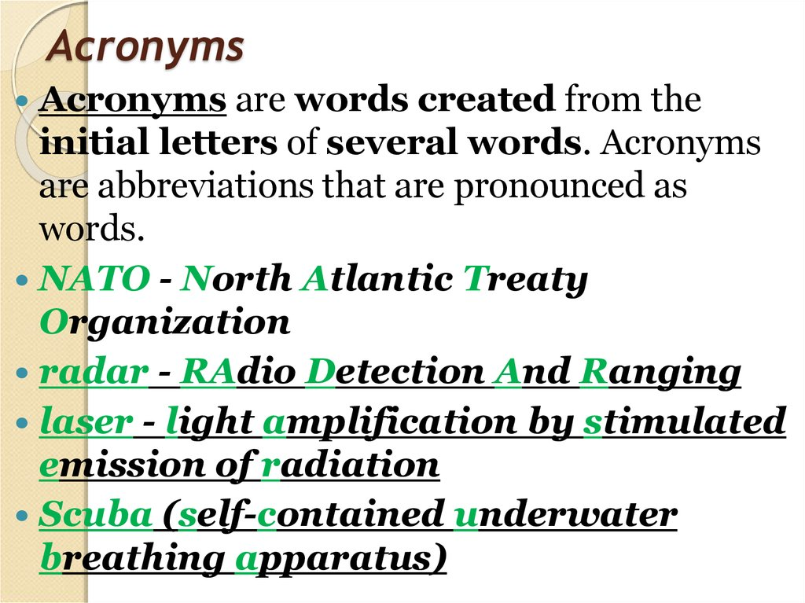
ABBREVIATIONS AND ACHRONYMS
There are many common abbreviations that are used in academic and technical texts. Understanding their meaning will help to understand the text better.
Some abbreviations are said as individual letters, e.g. BBC. Some are achronyms, that is said as words, e.g. OPEC.

Slide 13
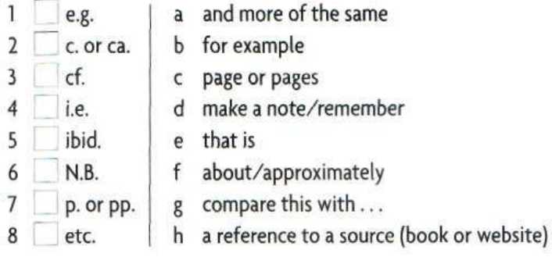
Match abbreviations 1-8 with their meanings a- h. Check your answer in a dictionary.

Slide 14
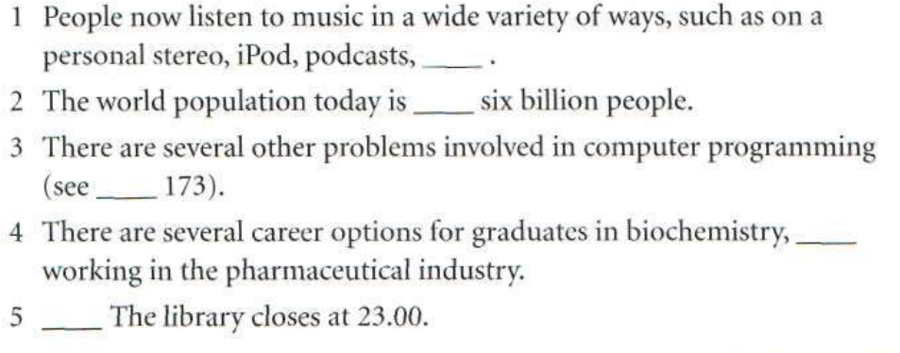
Complete the sentences using abbreviations

Slide 15
FORMATTING THE GLOSSARY
PUT THE TERMS IN ALPHABETICAL ORDER
SEPARATE THE TERMS WITH BULLET POINTS OR SPACING
ITALICIZE OR BOLD THE TERMS IN THE GLOSSARY
- PLACE THE GLOSSARY BEFORE OR AFTER THE MAIN TEXT

Slide 16
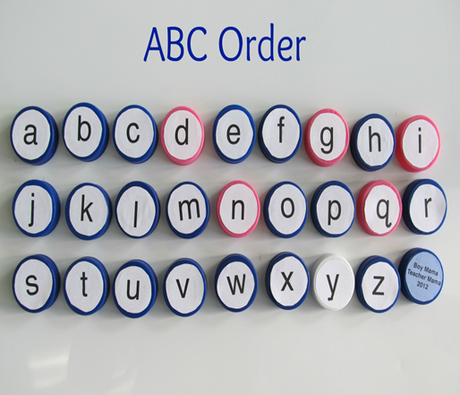
PUT THE TERMS IN ALPHABETICAL ORDER
Once the definitions for the terms have been completed, you should place the terms in alphabetical order, starting with “A” and ending with “Z.” Having the glossary terms in alphabetical order will make it easier for the reader to flip through the terms to find the one they are looking for.
Make sure you order the terms by first letter and then by the second letter in the term. For example, in the “A” section of the glossary, “Apple” will appear before “Arrange,” as “p” appears before “r” in the alphabet. If a term has multiple words, use the first word in the phrase to determine where to put it in the glossary.

Slide 17
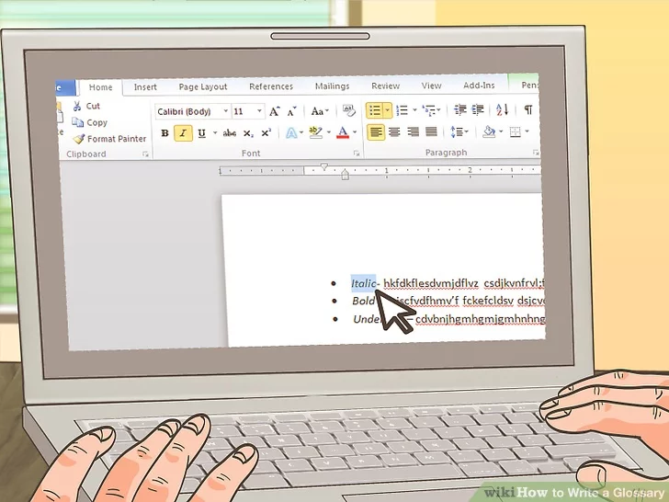
SEPARATE THE TERMS
WITH BULLET POINTS OR SPACING
You should also separate each term using bullet points before each term so they are easy to read. Or you can use one space between each term so they are not jammed together in the glossary. Choose one formatting style and stick to it so the glossary looks clean and polished.
You may also have sub-bullets within one glossary entry for a term if there are sub-concepts or ideas for one term. If this is the case, put a sub-bullet under the main bullet so the content is easy to read.

Slide 18
ITALICIZE OR BOLD THE TERMS
IN THE GLOSSARY
You can also format the glossary to be more user-friendly by italicizing or bolding the terms in the glossary. This can make the terms stand out from the definitions and make them easier to spot in the text. Choose either italicizing or bolding for the terms and stick to one formatting style so the glossary appears uniform.

Slide 19

PLACE THE GLOSSARY
BEFORE OR AFTER THE MAIN TEXT
Once you have formatted the glossary, you should place it either before or after the main text. Make sure the glossary appears in the Table of Contents for the paper as “Glossary” with the appropriate page numbers.
If you have other additional content in the paper, such as a “List of Abbreviations,” the glossary will traditionally be placed after these lists as the last item in the paper.
If you are creating a glossary for an academic paper, your teacher may indicate where they would prefer the glossary in the paper.
If you are creating a glossary for a text for publication, ask your editor where they would prefer the glossary to fall in the text. You can also look at other texts that have been published and note where they place the glossary.

Slide 20
USE THE GLOSSARY AS A STARTING POINT FOR RESEARCHING DIFFERENT INTERPRETATIONS OF THE FOLLOWING CONTROVERSIAL TERMS:
Balance of power | Nation state
Globalization | Norm
Global governance | Social media and Web
Human security | Sovereignty
International anarchy | Sovereign state
Legitimacy | Statecraft

Slide 21
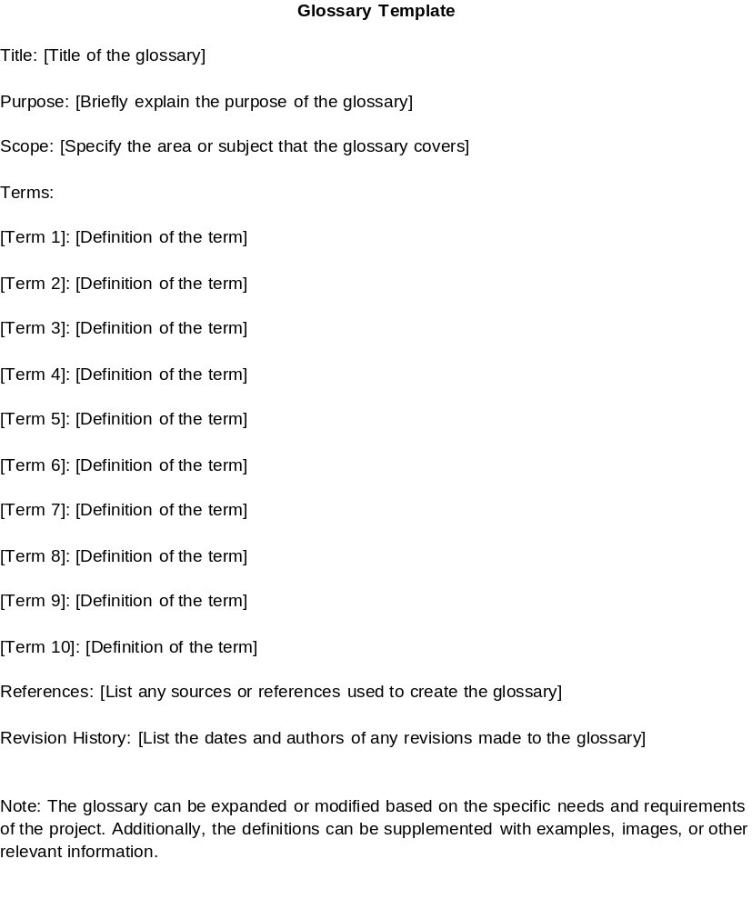

Slide 22

Source: https://www.wikihow.com/Write-a-Glossary

